Slide 1

Azure Fundamentals
AZ 900 DAY 2
TRAINER
Maruti Makwana
DATE
21st Sept 2021

Slide 2
SLAs for Azure products and services
Performance targets are expressed as uptime and connectivity guarantees.
Performance-targets range from 99.9% (three nines) to 99.99% (four nines).
If a service fails to meet the guarantees, a percentage of the monthly service fees can be credited to you.
SLA | Downtime per month | Downtime per year
99.9% | 43.2 minutes | 8.76 hours
99.95 | 21.6 minutes | 4.38 hours
99.99 | 4.32 minutes | 52.56 minutes
Notes:
You might want to browse to some SLA’s directly https://azure.microsoft.com/en-us/support/legal/sla/summary/ and explore one or two as examples.

Slide 3
High Availability – Active Active
VM 1
VM 2
Load
Balancer

Slide 4
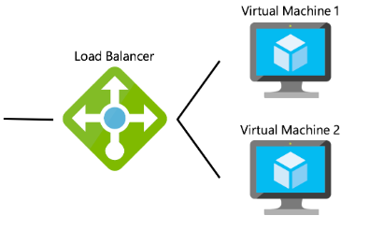
Azure Load Balance VM
Load balancing provides a higher level of availability and scale by spreading incoming requests across multiple virtual machines.
CLIENT

Slide 6
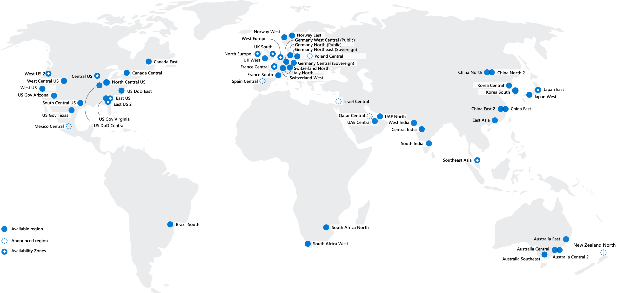
Regions
Azure offers more global regions than any other cloud provider with 60+ regions representing over 140 countries
Regions are made up of one or more datacenters in close proximity.
Provide flexibility and scale to reduce customer latency.
Preserve data residency with a comprehensive compliance offering.
Notes:
A region represents a collection of datacenters.
Provide flexibility and scale.
Preserve data residency.
Select regions close to your users.
Be aware of region deployment availability.
There are global services that are region independent.
A list of regions and their locations is available at https://azure.microsoft.com/en-us/global-infrastructure/locations/
Learn and SkillPipe content order note:
Slides 6-10
https://docs.microsoft.com/en-us/learn/modules/azure-architecture-fundamentals/regions-availability-zones

Slide 7
Region Pairs
Region
North Central US​
East US​
West US 2​
US East 2​
Canada Central​
North Europe​
UK West​
Germany Central​
South East Asia​
East China​
Japan East​
Australia Southeast​
India South​
Brazil South (Primary)​
Region
South Central US​
West US​
West Central US​
Central US​
Canada East​
West Europe​
UK South​
Germany Northeast​
East Asia​
North China​
Japan West​
Australia East​
India Central​
South Central US ​
At least 300 miles of separation between region pairs.
Automatic replication for some services.
Prioritized region recovery in the event of outage.
Updates are rollout sequentially to minimize downtime.
Web Link: https://aka.ms/PairedRegions
Notes:
Each Azure region is paired with another region.
Azure prefers at least 300 miles of separation between datacenters in a regional pair.
Some services provide automatic replication to the paired region.
In an outage, recovery of one region is prioritized out of every pair.
Azure system updates are rolled out to paired regions sequentially (not at the same time).
List of geographies, regions, region-pairs, and other details -https://azure.microsoft.com/en-us/global-infrastructure/geographies/
A full list of region pairs is available at https://docs.microsoft.com/en-us/azure/best-practices-availability-paired-regions#what-are-paired-regions
Learn and SkillPipe content order note:
Slides 6-10
https://docs.microsoft.com/en-us/learn/modules/azure-architecture-fundamentals/regions-availability-zones

Slide 8
Availability Options
VM SLA
99.9% with Premium Storage
VM SLA
99.99%
MULTI-REGION DISASTER RECOVERY
Region 1
Region 2
SINGLE VM
Easier lift and shift
AVAILABILITY ZONES
Protection from entire datacenter failures
REGION PAIRS
Regional protection within Data Residency Boundaries

Slide 9
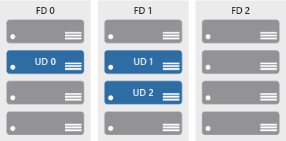
Define Availability sets
Keep applications online during maintenance or hardware failure.
Update domains (UD): Scheduled maintenance, performance or security updates are sequenced through update domains.
Fault domains (FD): Provide a physical separation of workloads across different hardware in a datacenter.

Slide 10

Define Availability zones
Azure Region
Availability Zone 1
Availability Zone 2
Physically separate locations within an Azure region.
Includes one or more datacenters, equipped with independent power, cooling, and networking.
If one availability zone goes down, the other continues working.
Availability Zone 3
Notes:
More details about Availability Zones in Azure are available at https://docs.microsoft.com/en-us/azure/availability-zones/az-overview
Physically separate locations within an Azure region.
Takes availability sets to the next level
Includes one or more datacenters, equipped with independent power, cooling, and networking.
Acts as an isolation boundary.
If one availability zone goes down, the other continues working.

Slide 11



Azure networking services
Azure Virtual Network (VNet) enables Azure resources to communicate with each other, the internet, and on-premises networks.
Virtual Private Network Gateway (VPN) is used to send encrypted traffic between an Azure virtual network and an on-premises location over the public internet.
Azure Express Route extends on-premises networks into Azure over a private connection that is facilitated by a connectivity provider.
Notes:
Learn and SkillPipe content order note:
Multiple Learn units cover the content in this slide
https://docs.microsoft.com/en-us/learn/modules/azure-networking-fundamentals/introduction
https://docs.microsoft.com/en-us/learn/modules/azure-networking-fundamentals/azure-virtual-network-fundamentals
https://docs.microsoft.com/en-us/learn/modules/azure-networking-fundamentals/azure-virtual-network-settings
https://docs.microsoft.com/en-us/learn/modules/azure-networking-fundamentals/azure-vpn-gateway-fundamentals
https://docs.microsoft.com/en-us/learn/modules/azure-networking-fundamentals/express-route-fundamentals

Slide 12



Azure storage services
Container storage (blob) is optimized for storing massive amounts of unstructured data, such as text or binary data.
Disk storage provides disks for virtual machines, applications, and other services to access and use.
Azure Files sets up a highly available network file shares that can be accessed by using the standard Server Message Block (SMB) protocol.
Notes:
Storage services - https://azure.microsoft.com/en-us/product-categories/storage/
Learn and SkillPipe content order note:
Multiple Learn units cover the content in this slide
https://docs.microsoft.com/en-us/learn/modules/azure-storage-fundamentals/introduction
https://docs.microsoft.com/en-us/learn/modules/azure-storage-fundamentals/azure-storage-accounts
https://docs.microsoft.com/en-us/learn/modules/azure-storage-fundamentals/azure-disk-storage
https://docs.microsoft.com/en-us/learn/modules/azure-storage-fundamentals/azure-blob-container-storage
https://docs.microsoft.com/en-us/learn/modules/azure-storage-fundamentals/azure-file-storage

Slide 13



Azure storage access tiers
Hot | Cool | Archive
Optimized for storing data that is accessed frequently. | Optimized for storing data that is infrequently accessed and stored for at least 30 days. | Optimized for storing data that is rarely accessed and stored for at least 180 days with flexible latency requirements.
You can switch between these access tiers at any time.
Notes:
Learn and SkillPipe content order note:
https://docs.microsoft.com/en-us/learn/modules/azure-storage-fundamentals/azure-storage-tiers

Slide 14




Azure compute services
Azure compute is an on-demand computing service that provides computing resources such as disks, processors, memory, networking, and operating systems.
Virtual
Machines
App
Services
Container Instances
Azure Kubernetes Services (AKS)
Notes:
https://azure.microsoft.com/en-us/services/app-service/#product-overview
Learn and SkillPipe content order note:
https://docs.microsoft.com/en-us/learn/modules/azure-compute-fundamentals/overview

Slide 15
Azure Container Services
Azure Containers are a light-weight, virtualized environment that does not require operating system management, and can respond to changes on demand.
Azure Container Instances: a PaaS offering that runs a container in Azure without the need to manage a virtual machine or additional services.
Azure Kubernetes Service: an orchestration service for containers with distributed architectures and large volumes of containers.
© Copyright Microsoft Corporation. All rights reserved.
Notes:
Containers are a virtualization environment. However, unlike virtual machines, you do not manage an operating system. Containers are meant to be lightweight, and are designed to be created, scaled out, and stopped dynamically.
Azure Container Instances - https://azure.microsoft.com/en-us/services/container-instances/
Azure Kubernetes Service - https://azure.microsoft.com/en-us/services/kubernetes-service/
Learn and SkillPipe content order note:
https://docs.microsoft.com/en-us/learn/modules/azure-compute-fundamentals/azure-container-services

Slide 16
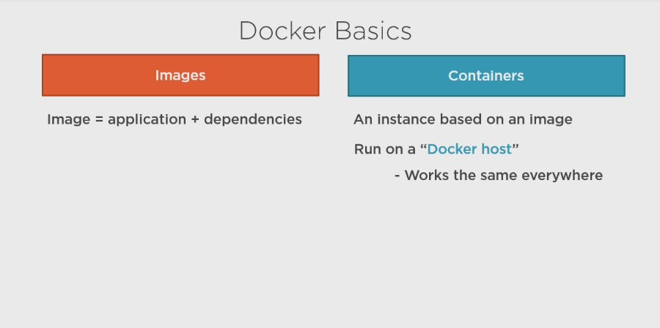

Slide 17
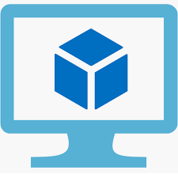


CODE
CONTAINER
LOGIC
LOGIC
Code
+
dep
App/API
LOGIC
IMAGE
LOGIC
Hosting environment
Docker HOST
IMAGE
VM
App Service
Azure Function
CONTAINER

Slide 18
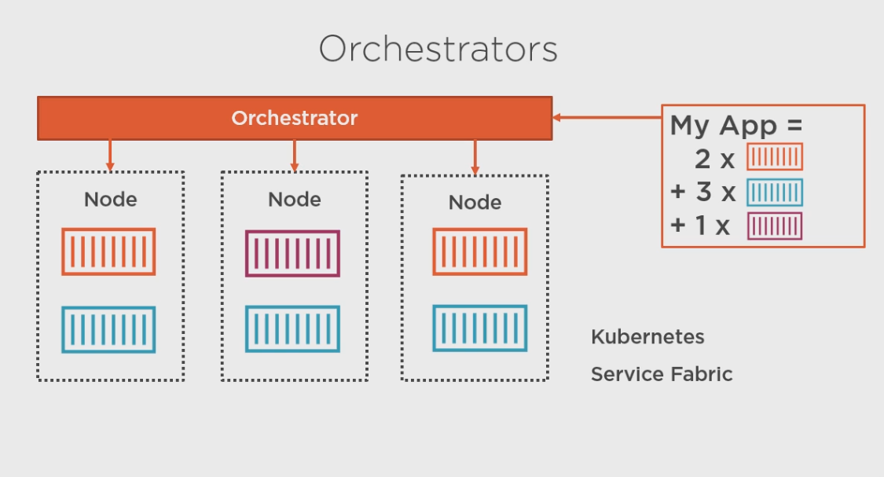

Slide 19



Serverless Computing
Azure Functions
Azure Logic Apps
Event based code running your service and not the underlying infrastructure.
Automate and orchestrate tasks, business processes, and workflows to integrate apps.
Notes:
Note: This topic is also introduced in Module 1, slide 23 (as it works well there), but is listed in the objective domain here.
Serverless computing is the evolution of cloud platforms in the direction of pure cloud native code. Serverless brings developers closer to business logic while insulating them from infrastructure concerns. It's a pattern that doesn't imply "no server" but rather, "less server." Serverless code is event-driven. Code may be triggered by anything from a traditional HTTP web request to a timer or the result of uploading a file. The infrastructure behind serverless allows for instant scale to meet elastic demands and offers micro-billing to truly "pay for what you use." Serverless requires a new way of thinking and approach to building applications and isn't the right solution for every problem.
Azure Functions is code running your service and not the underlying platform or infrastructure. Creates infrastructure based on an event.
Azure Logic Apps is a cloud service that helps you automate and orchestrate tasks, business processes, and workflows when you need to integrate apps, data, systems, and services.
Azure Event Grid is a fully-managed, intelligent event routing service that uses a publish-subscribe model for uniform event consumption.
Azure Functions - https://docs.microsoft.com/en-us/azure/azure-functions/
Azure Logic Apps - https://docs.microsoft.com/en-us/azure/logic-apps/
Azure Event Grid - https://docs.microsoft.com/en-us/azure/event-grid/
Note: For more details about serverless services available with Azure, see https://azure.microsoft.com/en-us/solutions/serverless/
Learn and SkillPipe content order note:
Multiple Learn units cover the content in this slide
https://docs.microsoft.com/en-us/learn/modules/serverless-fundamentals/1-introduction
https://docs.microsoft.com/en-us/learn/modules/serverless-fundamentals/2-identify-product-options
https://docs.microsoft.com/en-us/learn/modules/serverless-fundamentals/3-analyze-decision-criteria
https://docs.microsoft.com/en-us/learn/modules/serverless-fundamentals/4-use-azure-functions
https://docs.microsoft.com/en-us/learn/modules/serverless-fundamentals/5-use-azure-logic-apps

Slide 20


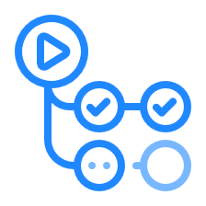

Develop your apps with DevOps and GitHub
Azure DevOps: development collaboration tools including pipelines, Kanban boards, and automated cloud-based load testing.
GitHub: software development hosting with version control, source code management, and bug/task management.
GitHub Actions for Azure: automate software workflow to build, test, and deploy from withing GitHub.
Azure DevTest Labs: quickly create environments in Azure while minimizing waste and controlling cost.
Notes:
Azure DevOps services provides development collaboration tools including pipelines, Git repositories, Kanban boards, and extensive automated and cloud-based load testing.
Azure DevTest Labs allows you to quickly create environments in Azure while minimizing waste and controlling cost.
GitHub is an American provides hosting for software development and version control using Git. It offers the distributed version control and source code management (SCM) functionality of Git, plus its own features. It provides access control and several collaboration features such as bug tracking, feature requests, task management, and wikis for every project.
GitHub Actions makes it easy to automate all your software workflows, now with world-class CI/CD. Build, test, and deploy your code right from GitHub. Make code reviews, branch management, and issue triaging work the way you want.
Azure DevOps Services - https://docs.microsoft.com/en-us/azure/devops/
Azure DevTest Labs - https://azure.microsoft.com/en-us/services/devtest-lab/
Note: For more general details on DevOps services available with Azure, see https://docs.microsoft.com/en-us/azure/#pivot=products&panel=devops
Learn and SkillPipe content order note:
Multiple Learn units cover the content in this slide
https://docs.microsoft.com/en-us/learn/modules/azure-devops-devtest-labs/1-introduction
https://docs.microsoft.com/en-us/learn/modules/azure-devops-devtest-labs/2-identify-product-options
https://docs.microsoft.com/en-us/learn/modules/azure-devops-devtest-labs/3-analyze-decision-criteria
https://docs.microsoft.com/en-us/learn/modules/azure-devops-devtest-labs/4-use-azure-devops
https://docs.microsoft.com/en-us/learn/modules/azure-devops-devtest-labs/5-use-github
https://docs.microsoft.com/en-us/learn/modules/azure-devops-devtest-labs/6-use-azure-devtest-labs

Slide 21

Azure Monitor
Azure Monitor maximizes the availability and performance of applications and services by collecting, analyzing, and acting on telemetry from cloud and on-premises environments.
Application Insights
Log Analytics
Smart Alerts
Automation Actions
Customized Dashboards
Notes:
Collect, analyse, and act on telemetry from cloud and on-premises environments, to maximize your applications’ availability and performance.
Starts collecting data as soon as you create an Azure subscription and add resources.
Activity Logs record all resource creation and modification events.
Metrics measure resource performance and consumption.
Add an Azure monitor agent to collect operational data for a resource.
Azure Monitor - https://azure.microsoft.com/en-us/services/monitor/
Learn and SkillPipe content order note:
Multiple Learn units cover the content in slide 19-23
https://docs.microsoft.com/en-us/learn/modules/monitoring-fundamentals/1-introduction
https://docs.microsoft.com/en-us/learn/modules/monitoring-fundamentals/2-identify-product-options
https://docs.microsoft.com/en-us/learn/modules/monitoring-fundamentals/3-analyze-decision-criteria
https://docs.microsoft.com/en-us/learn/modules/monitoring-fundamentals/4-use-azure-advisor
https://docs.microsoft.com/en-us/learn/modules/monitoring-fundamentals/5-use-azure-monitor
https://docs.microsoft.com/en-us/learn/modules/monitoring-fundamentals/6-use-azure-service-health

Slide 22

Explore Azure Service Health
Evaluate the impact of Azure service issues with personalized guidance and support, notifications, and issue resolution updates.
Azure Status | Service Health | Azure Resource Health
Notes:
Azure Service Health - https://azure.microsoft.com/en-us/services/monitor/
Components of Azure service health :
Azure Status provides a global overview Azure services’ state of health.
Service Health has a customizable dashboard for tracking the state of services in the regions you use.
Azure Resource Health can diagnose and obtain support for Azure service issues affecting your resources.

Slide 23
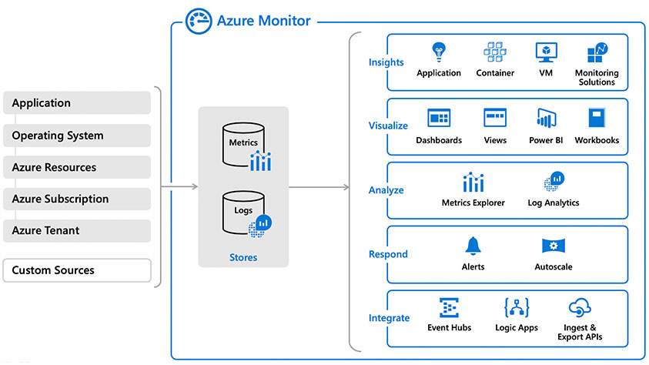
Azure Monitoring
AZ-900 Microsoft Azure Fundamentals
M
A
D
A
M

Slide 24
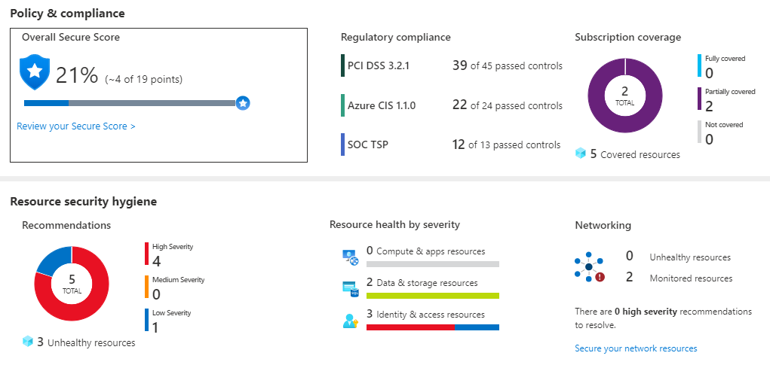
Azure Security Center
Azure Security Center is a monitoring service that provides threat protection across both Azure and on-premises datacenters.
Provides security recommendations
Detect and block malware
Analyze and identify potential attacks
Just-in-time access control for ports
Notes:
Azure Security Center is a unified infrastructure security management system that strengthens the security posture of your data centers, and provides advanced threat protection across your hybrid workloads in the cloud - whether they're in Azure or not - as well as on premises.
Strengthen security posture: Security Center assesses your environment and enables you to understand the status of your resources, and whether they are secure.
Protect against threats: Security Center assesses your workloads and raises threat prevention recommendations and security alerts.
Get secure faster: In Security Center, everything is done in cloud speed. Because it is natively integrated, deployment of Security Center is easy, providing you with auto-provisioning and protection with Azure services.
Policy compliance
Security Center is built on top of Azure Policy controls so you can set and monitor your policies to run on management groups, across subscriptions, and even for a whole tenant.
Security alerts
Security Center automatically collects, analyzes, and integrates log data from your Azure resources like firewall and endpoint protection to detect real threats. Then list of prioritized security alerts is shown in Security Center along with the information you need to quickly investigate and remediate an attack.
Secure score
Security Center continually assesses your resources for security issues; then aggregates all the findings into a single score so that you can tell your current security situation.
Resource Security Hygiene
Security visibility and recommendations by resource.
Azure Security - https://azure.microsoft.com/en-us/services/security-center/
Learn and SkillPipe content order note:
Slides 6 & 8-9
https://docs.microsoft.com/en-us/learn/modules/protect-against-security-threats-azure/2-protect-threats-security-center

Slide 25
Define Shared security
Responsibility | On-Premises | IaaS | PaaS | SaaS
Data governance and Rights Management | Customer | Customer | Customer | Customer
Client endpoints | Customer | Customer | Customer | Customer
Account and access management | Customer | Customer | Customer | Customer
Identity and directory infrastructure | Customer | Customer | Microsoft/ Customer | Microsoft/ Customer
Application | Customer | Customer | Microsoft/ Customer | Microsoft
Network controls | Customer | Customer | Microsoft/ Customer | Microsoft
Operating system | Customer | Customer | Microsoft | Microsoft
Physical hosts | Customer | Microsoft | Microsoft | Microsoft
Physical network | Customer | Microsoft | Microsoft | Microsoft
Physical datacenter | Customer | Microsoft | Microsoft | Microsoft
Migrating from customer-controlled to cloud-based datacenters shifts the responsibility for security.
Security becomes a shared concern between cloud providers and customers.
Notes:
This is comparable to the Shared Responsibility slide, but specific to security.

Slide 26


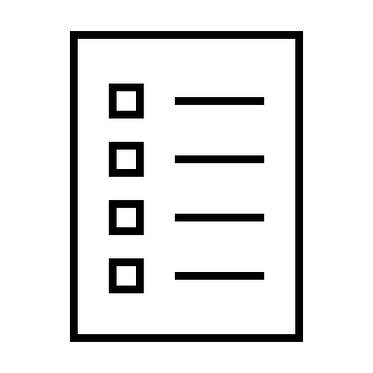





Compare Authentication and authorization
Two concepts are fundamental to understanding identity and access.
Authentication
Authorization
Notes:
✔️Authentication is sometimes shortened to AuthN, and authorization is sometimes shortened to AuthZ.
Authentication
Identifies the person or service seeking access to a resource.
Requests legitimate access credentials.
Basis for creating secure identity and access control principles.
Authorization
Determines an authenticated person’s or service’s level of access.
Defines which data they can access, and what they can do with it.

Slide 27

Explore Azure Active Directory (AD)
Microsoft Azure’s cloud-based identity and access management service.
Authentication (employees sign-in to access resources).
Single sign-on (SSO).
Application management.
Business to Business (B2B).
Business to Customer (B2C) identity services.
Device management.
Notes:
Azure AD - https://azure.microsoft.com/en-us/services/active-directory/

Slide 28
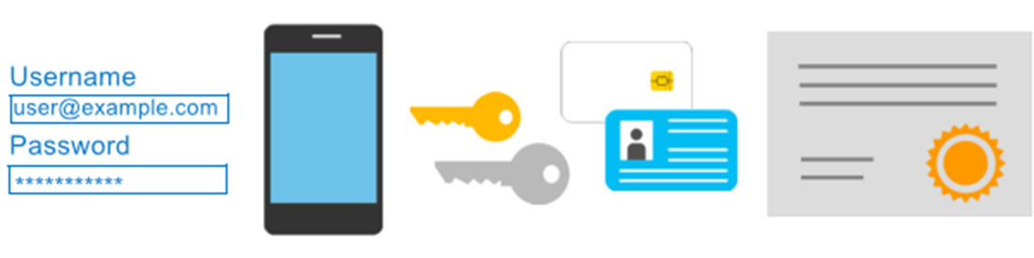
Azure MFA
AZ-900 Microsoft Azure Fundamentals
Provides additional security for your identities by requiring two or more elements for full authentication.
Something you know.
Something you possess.
Something you are.
MENTOR’S TAG – Make Yourself Future Ready

Slide 29

Explore Azure Security Center
A monitoring service that provides threat protection across all your Azure, and on-premises, services.
Security recommendations
Monitors security settings
Automatically applies your security policies
Notes:
Azure Security https://azure.microsoft.com/en-us/services/security-center/
Provides security recommendations based on your configurations, resources, and networks.
Monitors security settings across your on-premises and cloud workloads.
Automatically applies your security policies to any new services you provision.

Slide 30

Azure Key Vault
AZ-900 Microsoft Azure Fundamentals
Stores application secrets in a centralized cloud location, to securely control access permissions, and access logging.
Secrets management.
Key management.
Certificate management.
Storing secrets backed by hardware security modules (HSMs).
MENTOR’S TAG – Make Yourself Future Ready

Slide 31

Define Azure Policy
Azure Policy is a service to create, assign, and, manage policies. These policies enforce different rules and effects over your resources, so those resources stay compliant with your corporate standards and service-level agreements (SLAs).
Notes:
Azure Policy - https://azure.microsoft.com/en-us/services/azure-policy
Stay compliant with your corporate standards and service level agreements (SLAs) by using policy definitions to enforce rules and effects for your Azure resources.
Evaluates and identifies Azure resources that do not comply with your policies.
Provides built-in policy and initiative definitions, under categories such as Storage, Networking, Compute, Security Center, and Monitoring.

Slide 32
Implementing Azure Policy
Create a policy definition
Assign the definition to resources
Review the evaluation results
A policy definition expresses what to evaluate and what action to take.
Implement your policy definition by assigning it to a group of resources.
Review the results. Results are either compliant or non-compliant.
Notes:
✔️ Policy evaluation happens about once an hour, which means that if you make changes to your policy definition and create a policy assignment then it will be re-evaluated over your resources within the hour.
Azure Policy Samples - https://docs.microsoft.com/en-us/azure/governance/policy/samples/

Slide 33
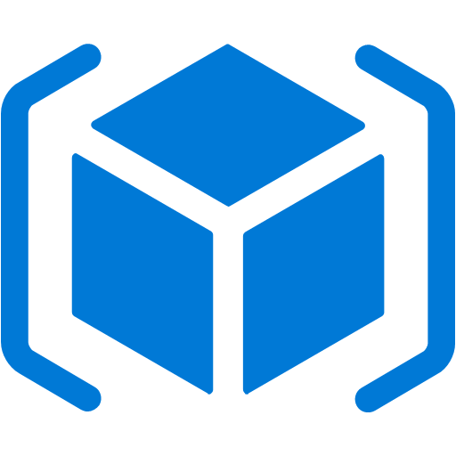

Explore Tags
Provides metadata for your Azure resources.
Logically organizes resources into a taxonomy.
Consists of a name-value pair.
Very useful for rolling up billing information.
OR
owner: joe
department: marketing
environment: production
cost-center: marketing
Notes:
Tags - https://docs.microsoft.com/en-us/azure/azure-resource-manager/resource-group-using-tags

Slide 34




Azure database services
Azure Cosmos Database is a globally-distributed database service that elastically and independently scales throughput and storage.
Azure SQL Database is a relational database as a service (DaaS) based on the latest stable version of the Microsoft SQL Server database engine.
Azure Database for MySQL is a fully-managed MySQL database service for app developers.
Azure Database for PostgreSQL is a relational database service based on the open-source Postgres database engine.
© Copyright Microsoft Corporation. All rights reserved.
Notes:
✔️ These are just a few of our database service offerings. Take a minute to review other database services and [find the product you need](https://azure.microsoft.com/en-us/product-categories/databases/).
Azure Cosmos DB - https://azure.microsoft.com/en-us/services/cosmos-db/
Azure SQL Database - https://azure.microsoft.com/en-us/services/sql-database/
Learn and SkillPipe content order note:
Multiple Learn units cover the content in this slide
https://docs.microsoft.com/en-us/learn/modules/azure-database-fundamentals/introduction
https://docs.microsoft.com/en-us/learn/modules/azure-database-fundamentals/azure-cosmos-db
https://docs.microsoft.com/en-us/learn/modules/azure-database-fundamentals/azure-sql-database
https://docs.microsoft.com/en-us/learn/modules/azure-database-fundamentals/azure-mysql-database
https://docs.microsoft.com/en-us/learn/modules/azure-database-fundamentals/azure-postgresql-database

Slide 35



Azure Internet of Things
Internet of Things (IoT) is the ability for devices to garner and then relay information for data analysis.
Azure IoT Central is a fully managed global IoT SaaS solution that makes it easy to connect, monitor, and manage IoT assets at scale.
Azure IoT Hub is a managed service hosted in the cloud that acts as a central message hub for bi-directional communication between IoT applications and the devices it manages.
Azure Sphere is a secured, high-level application platform with built-in communication and security features for internet-connected devices.
Notes:
Azure IoT Central -- is a fully-managed global IoT SaaS solution that makes it easy to connect, monitor, and manage your IoT assets at scale.
Azure IoT Hub -- is a managed service hosted in the cloud that acts as a central message hub for bidirectional communication between your IoT application and the devices it manages.
Azure IoT Sphere -- is a comprehensive IoT security solution—including hardware, OS, and cloud components.
These are just three of our IoT offerings. Use the IoT Product Selector to determine what product is best for your situation - https://azure.microsoft.com/en-us/overview/iot/product-selector/
IoT Central - https://docs.microsoft.com/en-us/azure/iot-central/
Azure IoT Hub - https://docs.microsoft.com/en-us/azure/iot-hub/
Azure IoT Sphere - https://docs.microsoft.com/en-us/azure-sphere/
For a full list of IoT-related services available with Azure, and for context on when you use them, see the page https://azure.microsoft.com/en-us/overview/iot/
Learn and SkillPipe content order note:
Multiple Learn units cover the content in this slide
https://docs.microsoft.com/en-us/learn/modules/iot-fundamentals/1-introduction
https://docs.microsoft.com/en-us/learn/modules/iot-fundamentals/2-identify-product-options
https://docs.microsoft.com/en-us/learn/modules/iot-fundamentals/3-analyze-decision-criteria
https://docs.microsoft.com/en-us/learn/modules/iot-fundamentals/4-use-iot-hub
https://docs.microsoft.com/en-us/learn/modules/iot-fundamentals/5-use-iot-central
https://docs.microsoft.com/en-us/learn/modules/iot-fundamentals/6-use-azure-sphere

Slide 36



Big data and analytics
Azure Synapse Analytics
Azure HDInsight
Azure Databricks
A cloud-based Enterprise Data Warehouse.
A fully-managed, open-source analytics service for enterprises.
Apache Spark based analytics service.
Notes:
Azure Synapse Analytics provides limitless analytics service that brings together enterprise data warehousing and Big Data analytics.
Azure HDInsight is a fully-managed, open-source analytics service for enterprises. It is a cloud service that makes it easier, faster, and more cost-effective to process massive amounts of data.
Azure DataBricks is a fast, easy, and collaborative Apache Spark based analytics service.
Get more information on each of these topics
Azure SQL Data Warehouse - https://azure.microsoft.com/en-us/services/sql-data-warehouse/
Azure HDInsight - https://azure.microsoft.com/en-us/services/hdinsight/
Azure Data Lake Analytics - https://azure.microsoft.com/en-us/services/data-lake-analytics/
Data and Analytics services - https://azure.microsoft.com/en-us/product-categories/analytics/
Learn and SkillPipe content order note:
This page was moved to mirror the PPT flow and slides in SkillPipe, but not in Learn. You can access the Learn unit here…
https://docs.microsoft.com/en-us/learn/modules/azure-database-fundamentals/azure-big-data-analytics

Slide 37



Artificial Intelligence & Machine Learning
Azure Machine Learning: cloud-based to develop, train, and deploy machine learning models.
Cognitive Services: quickly enable apps to see, hear, speak, understand, and interpret a user’s needs.
Azure Bot Service: develop intelligent, enterprise-grade bots.
Notes:
Azure Machine Learning service provides a cloud-based environment used to develop, train, test, deploy, manage, and track machine learning models.
Cognitive Services builds intelligent and supported algorithms into apps, websites, and bots to see, hear, speak, understand, and interpret your user needs.
Azure Bot Service develops intelligent, enterprise-grade bots that let you maintain control of your data.
Learn more at:
Azure Machine Learning Service - https://azure.microsoft.com/en-us/services/machine-learning-service/
Azure Machine Learning Studio - https://azure.microsoft.com/en-us/services/machine-learning-studio/
Note: For a full list of Artificial Intelligence and Machine Learning services available with Azure, see the AI + Machine Learning section on the https://azure.microsoft.com/en-us/overview/ai-platform/ page.
Learn and SkillPipe content order note:
Multiple Learn units cover the content in this slide
https://docs.microsoft.com/en-us/learn/modules/ai-machine-learning-fundamentals/1-introduction
https://docs.microsoft.com/en-us/learn/modules/ai-machine-learning-fundamentals/2-identify-product-options
https://docs.microsoft.com/en-us/learn/modules/ai-machine-learning-fundamentals/3-analyze-decision-criteria
https://docs.microsoft.com/en-us/learn/modules/ai-machine-learning-fundamentals/4-use-machine-learning
https://docs.microsoft.com/en-us/learn/modules/ai-machine-learning-fundamentals/5-use-cognitive-services
https://docs.microsoft.com/en-us/learn/modules/ai-machine-learning-fundamentals/6-use-bot-services

Slide 38
Azure Fundamentals
AZ 900
THANK YOU
Email
Maruti_Makwana@hotmail.com

